Slide 1
Submission to Waikato District Council
Steven and Theresa Stark
29 October 2020

Slide 2
Who We Are
Sheep and Beef farmers on 1400-acre property
Purchased our farm in 2003 with a loan and plans to develop it into a top producing sheep & beef farm and bull leasing operation
Steven was an owner of the farm previously in partnership with his brothers from 1991 to 2003
Steven’s family has farmed in the area since 1965 and are still doing so

Slide 4
Why Are We Here Today?
To tell you our concerns about:
The consultation process in the hope of improving it
Process issues which require addressing
Putting designations over private property without accuracy or sufficient data
Increased stringent rules that accompany those designations for landowners
Request relief
Notes:
Written submission is before you.
In 2015 Council adv. us there might be SNAs on our property. Wrote to tell them that some of the sites on their map were already cleared and others were consented for vegetation clearance. No reply. Understand SNA designation done via desktop exercise with no detailed field work. Excel spreadsheet circulated to DOC, WRC & WDC but not private landowners. Boffa Miskell was later engaged to produce the “Waikato District Landscape Study” report which was shared with WDC staff & Iwi but not landowners. Report was finalized in June 2018 while landowners were receiving notices in May 2018 about designated sites on their property.

Slide 5
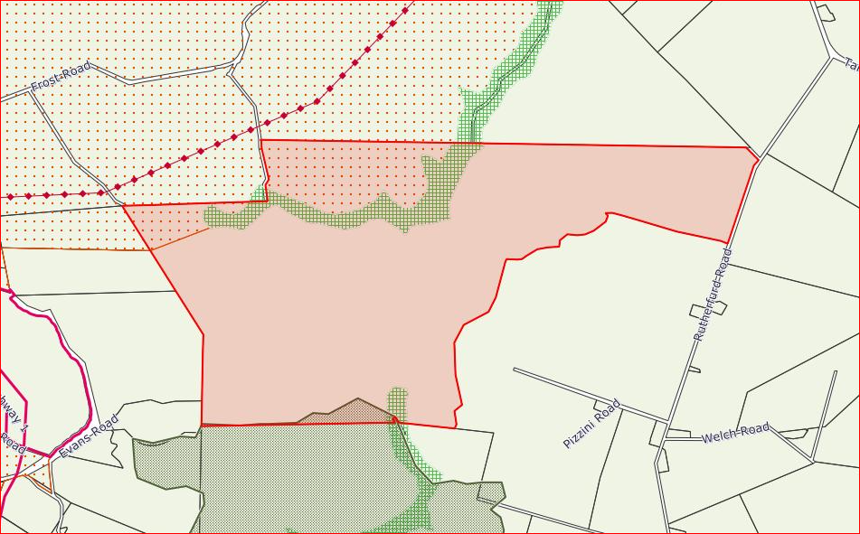
WDC Operative Plan

Slide 6
WDC Operative Plan
Ridgeline Policy Area
Coalmine Policy Area
Landscape Policy Area

Slide 7
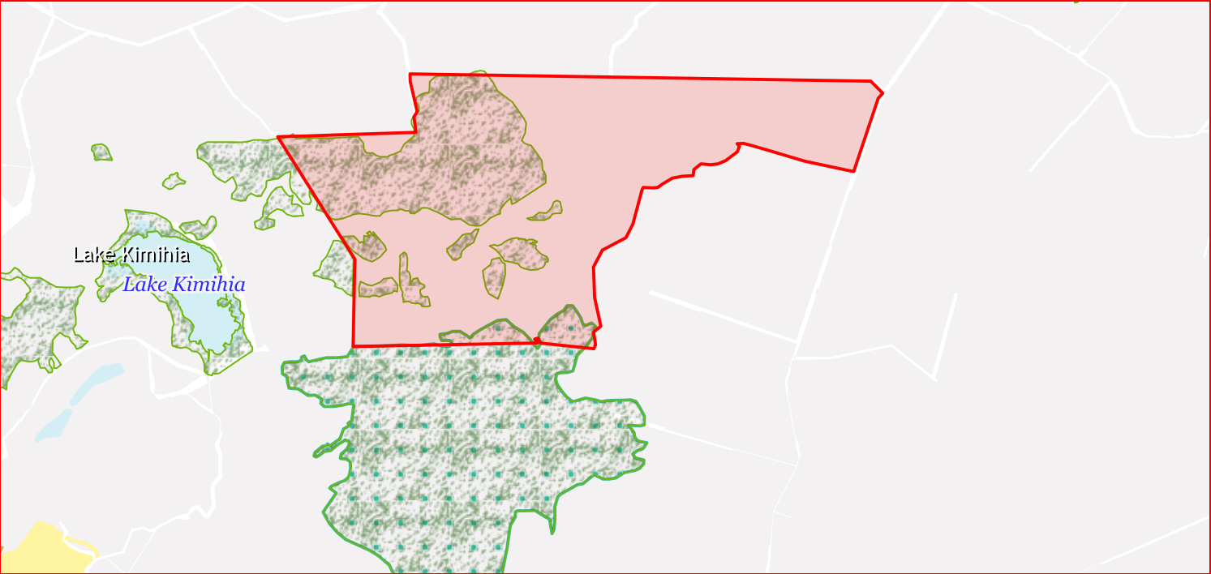
WDC Proposed Plan

Slide 8
WDC Proposed Plan
Significant Natural Areas (has legal effect)
Outstanding Natural Features
Notes:
Designations under the proposed plan cover about 1/3 of our far. It appears that Council is mapping any indigenous vegetation as significant or outstanding when that is not the case. Some of the identified SNAs were actually regenerating manuka and gorse. SNAs should represent only the most iconic & highly valued indig. Biodiversity –

Slide 9
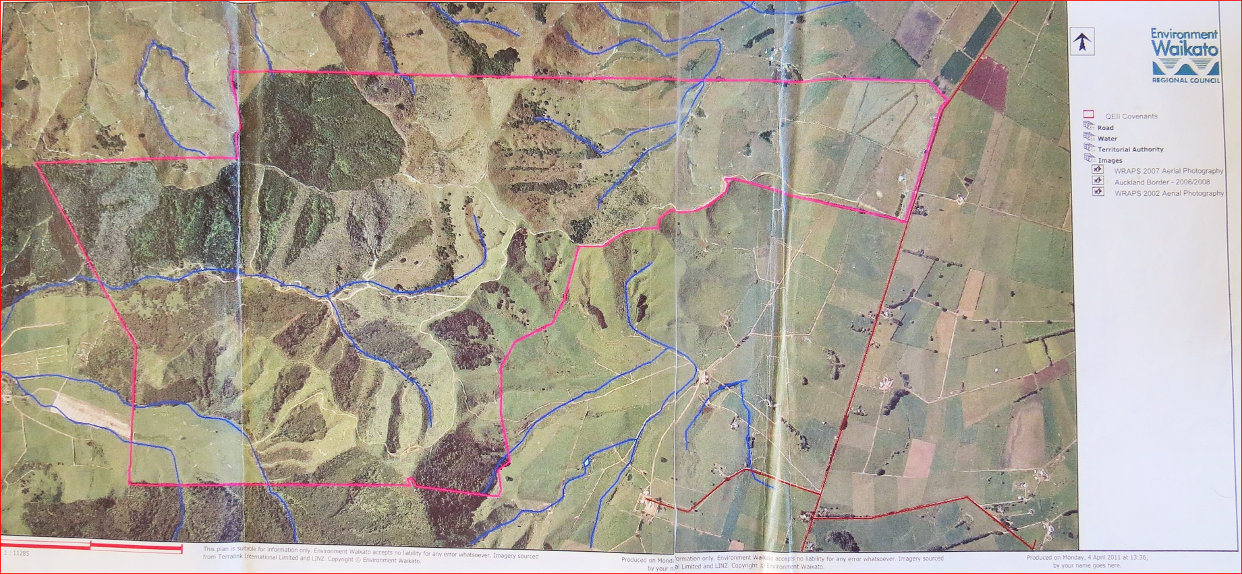
Notes:
This is a map from WRC dated 2011. It showed areas that were sprayed out approx. 2004 and would have been available to WDC prior notifying the proposed pan.

Slide 10
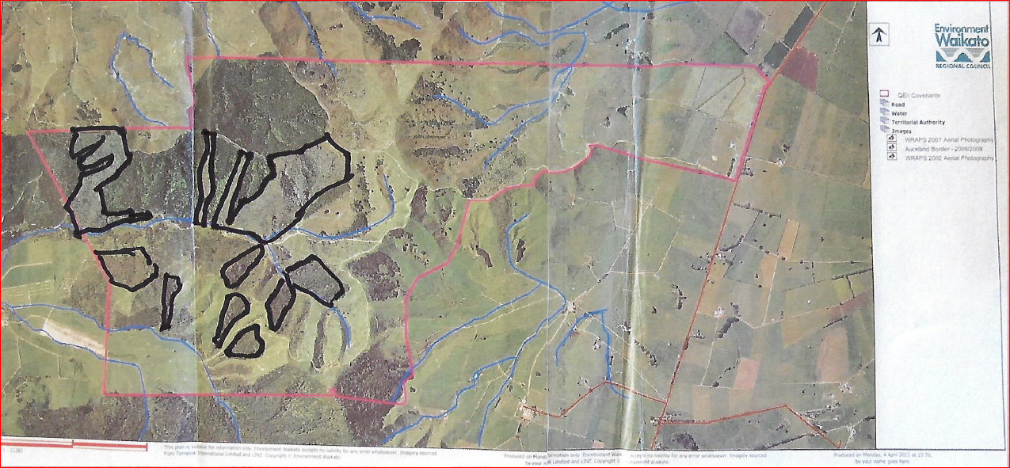
Notes:
This is the same map with the larger sprayed out areas outlined, as well as some smaller outlined areas that were consented for clearance by RC and DC. This information was made known to DC, but they took no heed and put SNA designations over them.

Slide 11
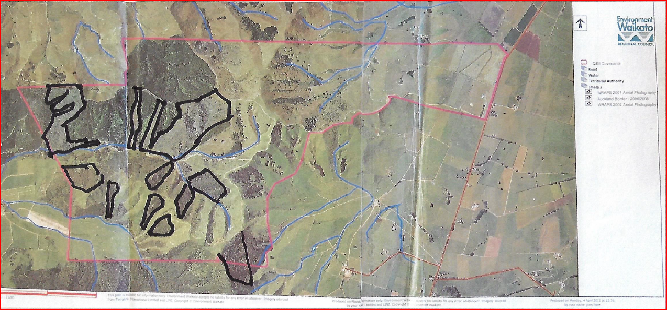
Track
Notes:
Concern re tighter earthworks restrictions. For example in the mapped ONF area we have an access track approx. 300 mtrs long. Under the proposed rules one can’t exceed 50m3 (approx. 7 truck loads of dirt). Of more concern is the 250 m2 limit to earthworks. If grading a 3 mtr carriageway with a mtr either side for water tables, you could only maintain 50 mtrs of the 300 mtr. Track. This is unworkable. People won’t do 50 mtrs maintenance per year – they will maintain the track all at once every 5 yrs or as needed. Or one must go to the time and expense of getting a resource consent. This puts a farmer at a competitive disadvantage to other farmers who do not have these onerous and costly restrictions.

Slide 12
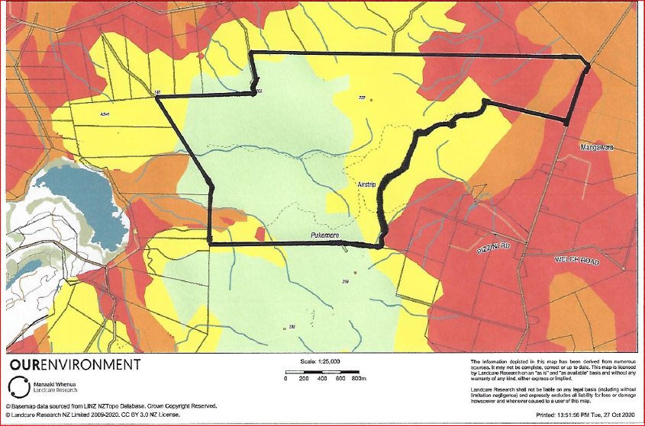
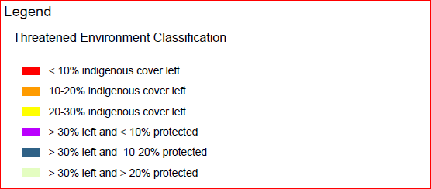
Category Name
Acutely Threatened
Chronically Threatened
At Risk
Critically Under-protected
Under-protected
Less Reduced & Better Protected
The Threatened Environment Classification is a combination of three national databases: Land Environments New Zealand (LENZ), classes Land Cover Database (LCDB) and the protected areas network (reflecting areas legally protected for the purpose of natural heritage protection). The classification combines this information into a simple and practical GIS tool. ‘Threatened environments’ (categories 1 to 5) are those in which much indigenous vegetation has been cleared and/or only a small proportion of what remains is legally protected.
Notes:
The WDC-commissioned Kessells report stated the main tool for the analysis of threatened environments within Wai District was Land Env. Of NZ (LENZ) Level IV. This slide shows our property with LENZ Level IV overlay. None of the areas designated by WDC as ONF or SNA are assessed as w/n the Natl Priority 1-Land for Biodiversity Protection – quite the opposite – the areas in question are in the non-threatened Category 6 - assessed as being less reduced and better protected in NZ

Slide 13
Category Name
Acutely Threatened
Chronically Threatened
At Risk
Critically Under-protected
Under-protected
Less Reduced & Better Protected
13%
5%
34%
48%
The Threatened Environment Classification is a combination of three national databases: Land Environments New Zealand (LENZ), classes Land Cover Database (LCDB) and the protected areas network (reflecting areas legally protected for the purpose of natural heritage protection). The classification combines this information into a simple and practical GIS tool. ‘Threatened environments’ (categories 1 to 5) are those in which much indigenous vegetation has been cleared and/or only a small proportion of what remains is legally protected.
Notes:
The idea of Threatened Envir. Classification is that it tries to offset how common different types of landscapes or land cover are against whether they’re protected or not. One needs to know both things. Landcare Research advises it has been quite expensive & difficult to organize the protected areas data because of all the QEII Trusts & all data has not been easily publicly available. Classifications haven’t been updated since 2012, because there’s no funding on the conservation side: DOC, QEIIs, DC, Reg Council reserves. It was quite a big & difficult job to try to collate the protected areas– only been done twice. Often you are told by environmental groups of the loss of vegetation or landforms with no balancing of the argument to show how much has also been protected. This can badly skew decision-making to overprotect when that is not necessary.

Slide 14
Findings of the MAC Report
In 2000 – Govt funded Ministerial Advisory Committee (MAC) to consult widely about biodiversity on private land
Key underpinning assumption of the Report – “successful nature conservation requires willing and motivated landowners”
Increased regulation on private land can provoke resistance and undermine goodwill – making it ineffective and counterproductive & does not create willing and motivated landowners

Slide 15
Relief Sought
Talk to landowners before placing designations such as SNA and ONF on their property.
If constricting rights on private property for public good, offer an incentive to offset the cost to the landowner and increase goodwill, i.e. transferable development rights
For landowners with such designations on their property, pay for any fencing and pest management required to keep vegetation healthy as without that – the area will most likely deteriorate and an alienated landowner will not take on those costs
Give meaningful rates relief for land with such designations
Remove the SNA and ONF designations from our property

