Slide 1
Waikato District Council
2024-2034 Long Term Plan

Slide 2
Agenda
The journey so far
High level funding requirements
Rating impacts
Audit NZ
Next steps
Notes:
Nicole

Slide 3
2024-2034 Long Term Plan
The journey

Slide 4
Notes:
Nicole

Slide 5
Strategic Priorities
Consistent Delivery of core services
Improving Council responsiveness
Improving connectivity
Building community resilience
Supporting sustainable growth
Building relationships
Notes:
Nicole

Slide 6
Financial and infrastructure challenges
Inflation increasing
Interest rates rising
Compliance requirements increasing
Large asset base that requires maintenance
Communities' ability to pay
Growth projects remain in line with last LTP
Notes:
Nicole

Slide 7
Asset and Activity Planning
Additional compliance requirements
Maintaining our existing assets, costs more
Communities’ expectations for more/better
Continuing with work we’ve already started / committed to.
Dials on increased effort / investment.
Notes:
Nicole

Slide 8
Water Reform: Local Water Done Well
Dec 2023 Govt announced it would repeal Water Reform legislation.
New legislation with be enacted in Feb 2024 which reflects the new Govt direction of Local Water Done Well.
The legislation will restore council ownership and control of water assets.
Therefore, staff have planned for the provision of water services for the 2024-2034 LTP.

Slide 9
Asset and Activity Planning
Community expectations
 | Waikato District | Hamilton City
Water assets | 7 water supply plants 9 wastewater plants (4 are land based systems) | 1 water supply plant 1 wastewater plant
KMs of roading | 2,422km | 713km
Number of settlements | 36 | 1
Size | 4,188km² | 110km²
Population | 88,900 | 185,300
Notes:
6 Urban Areas (greater then 3000 people AND HAS urban services (reticulated water and wastewater))
30 Villages (contains a land use other than Rural (e.g settlement, rural residential) some urban services may apply)
29 Rural Areas

Slide 10
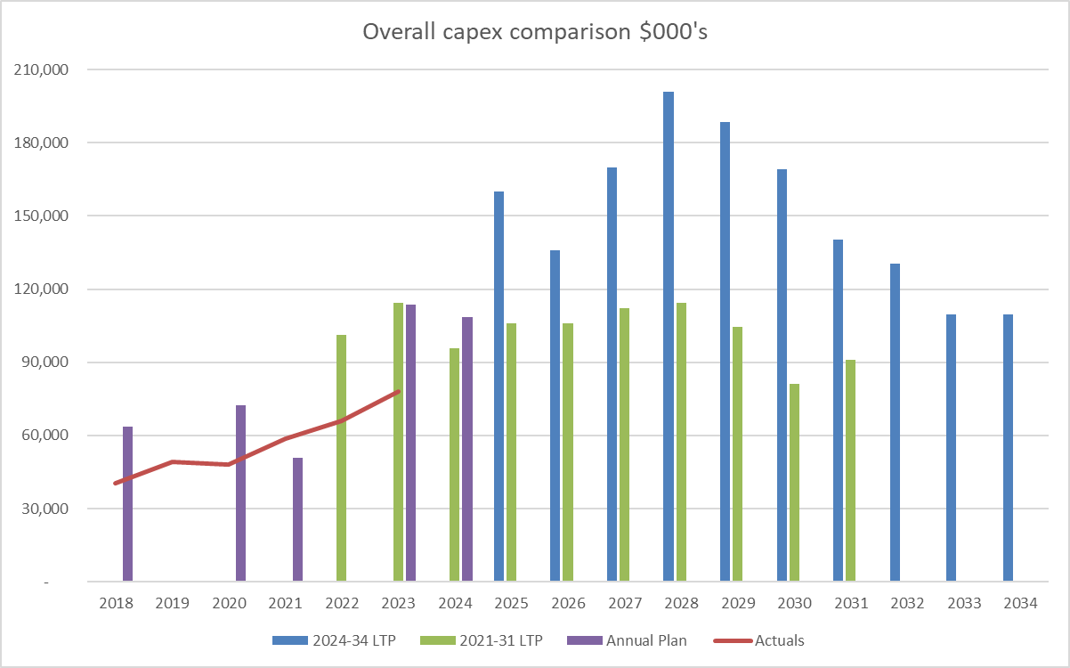
Notes:
What has changed – inflation was forecast between 2020-2023 to be 6-9% cummulatively, whereas the actual jump was 17% cummulatively. Inflation will settle

Slide 11
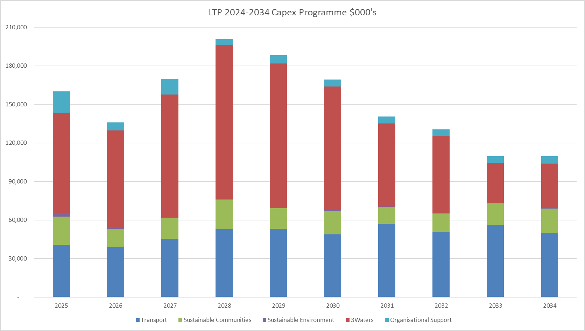

Slide 12
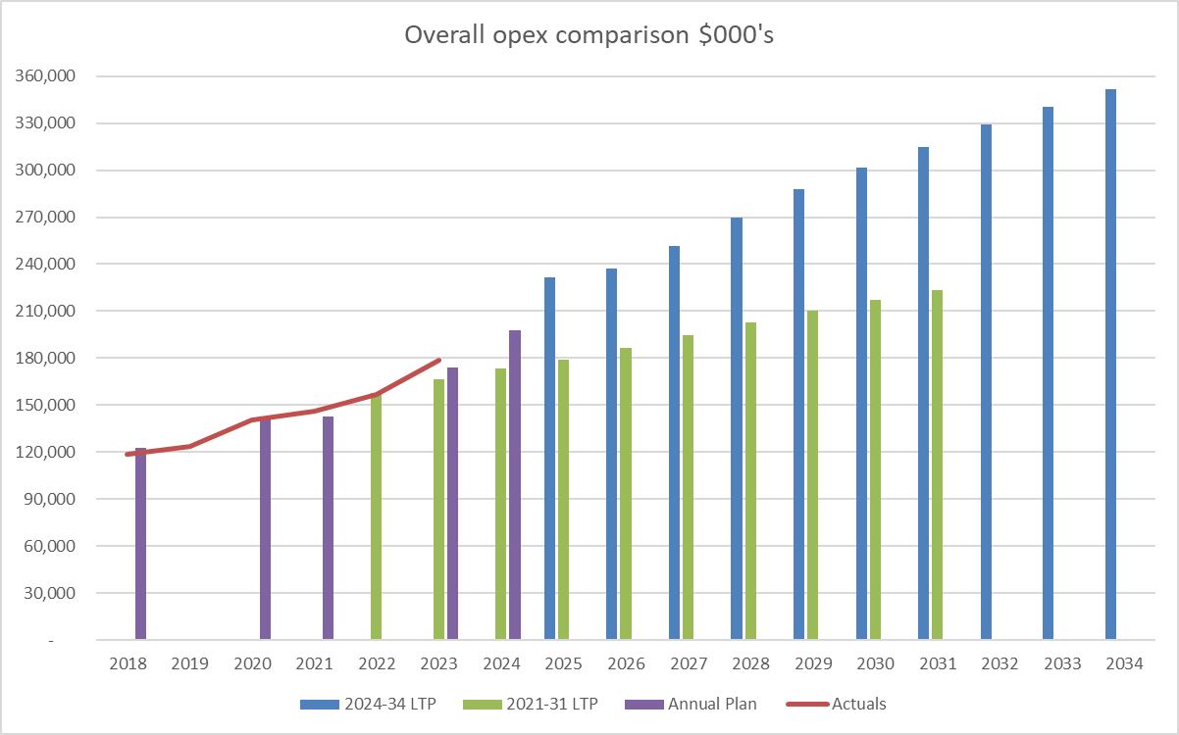
Notes:
Can we talk about Additional compliance requirements and maintaining our current assets contributing to these numbers.

Slide 13
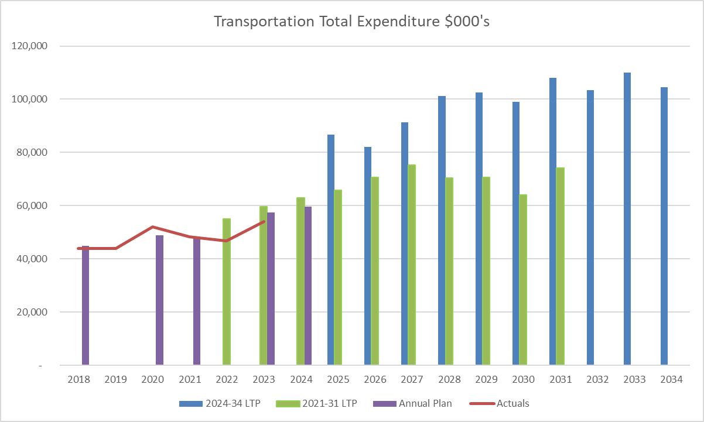

Slide 14
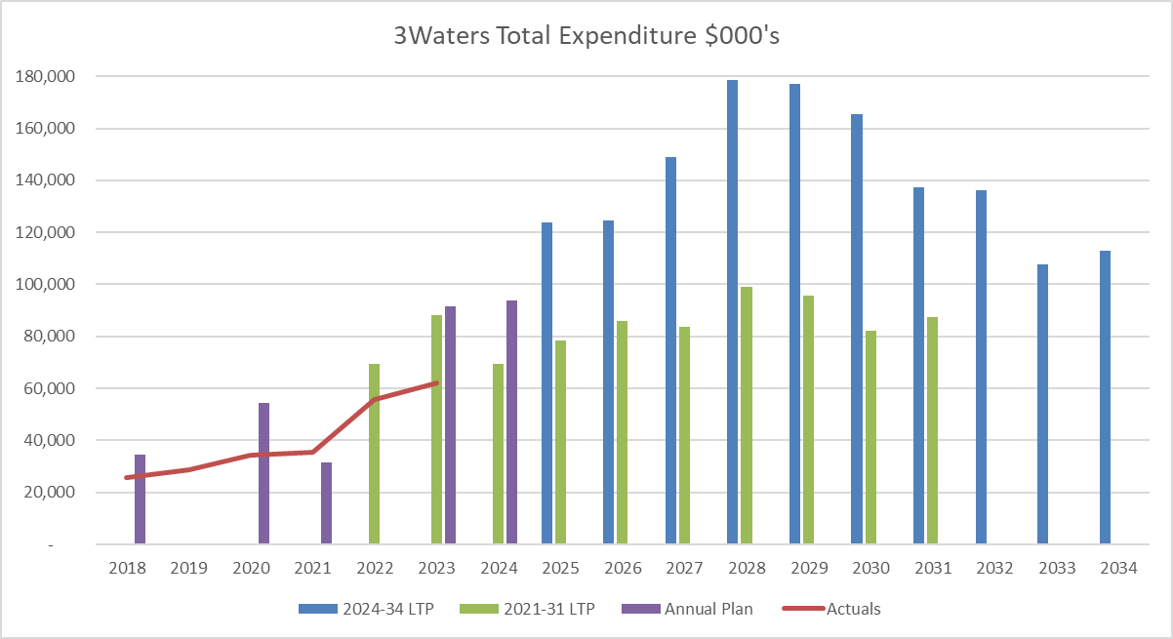

Slide 15
Areas of investment
Savings / external funds
Examples:
Mana Whenua forums
IT systems upgrades
Resilience planning and adaptative management
Transport
Wastewater infrastructure (Targeted Rate funded )
Rural Economic Advisory Panel
Examples:
$2m+ in efficiency savings.
Assumed central govt funding for Huntly Wastewater Plant.
Assumed external funding for some roading projects.
13.75%
General Rate increase in Year 1
6% Increase in Years 2 to 5
3.5% Increase in Years 6 to 10
Note 1% GR is ~$866k
Notes:
Continuing with work we’ve already started / committed to.
Dials on increased effort / investment.

Slide 16
How does this compare to others…?
Early indications from others:
Hamilton City: 25.5%
Auckland: 7.5% GR + targeted rates
Hutt City: 15.9%
Wellington City: 13.8%
Christchurch: 13.3%

Slide 17
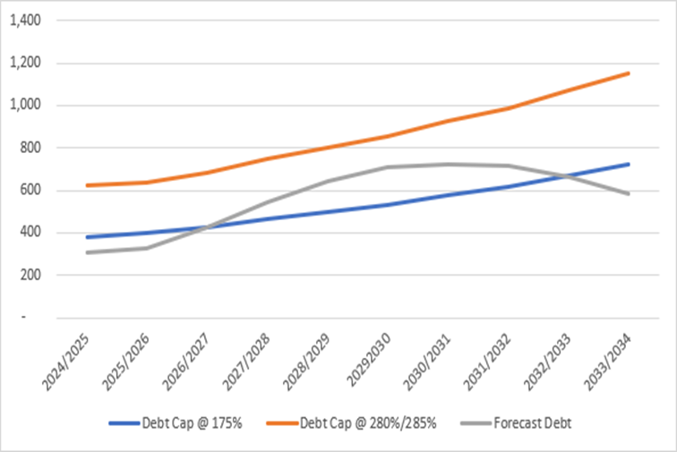
Budget Challenge
Debt cap
Our existing strategy debt cap of 175% of revenue is exceeded in Year 4
Notes:
Alison:
Using the LGFA caps we can borrow up to 285% of revenue in Year 1 and 280% thereafter

Slide 18
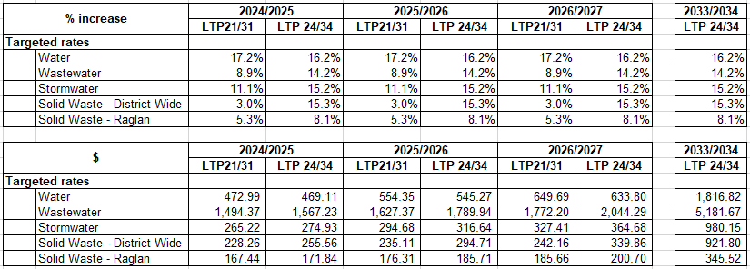
Targeted Rates
Budgeted targeted rates increase by the same percentage each year
Notes:
Alison:
Targeted rates – growth portion goes up, local share goes up – DC's expected to reflect large increases too

Slide 19
CD and Auditing
As a result of the new waters legislation Council will have some options:
Stick to original LTP timelines and process.
Extend the deadline for adopting your LTP to 30 September 2024.
Audit NZ don’t provide an audit opinion on your Consultation Document.

Slide 20
Next Steps
Date | Activity
7 / 8 Feb | Council workshop on detailed budgets
28 / 29 Feb | Council meeting to adopt budget and consultation topics
19 Mar | Adopt Consultation Document
25 Mar – 26 Apr | Consultation
14-16 May | Hearings
4-7 June | Deliberations
25 June | 2024-2034 LTP adoption

